Slide 1










ARM Data Workbench & JupyterHub
Maxwell Grover
Argonne National Laboratory
Kyle Dumas
Oak Ridge National Laboratory
Kyle Dumas
Data Tools Lead
Will Provenza
System Admin
Wade Darnell
User Tools Lead
Michael Giansiracusa
DevOps Lead
Sujata Goswami
DevOps / HPC
Max Grover
Open Source Guru

Slide 2
A Quick Note
If you run into issues logging in to JupyterHub, there are representatives from the ARM Data Booth ready to assist.

Slide 3
What is the ARM Data Workbench
The ARM Data Workbench (ADW) is a revolutionary ecosystem for interacting with ARM data. It is intended to utilize the ARM Data Center's (ADC) full capabilities to improve users' experience in working with ARM data. A few of these capabilities include:
Seamless access to data and computing resources
Direct access to ARM and community-developed software packages
Jupyter notebook ecosystem for data access, analysis and sub-setting
Easy generation of standard and custom plots
Integration of external data sets

Slide 4
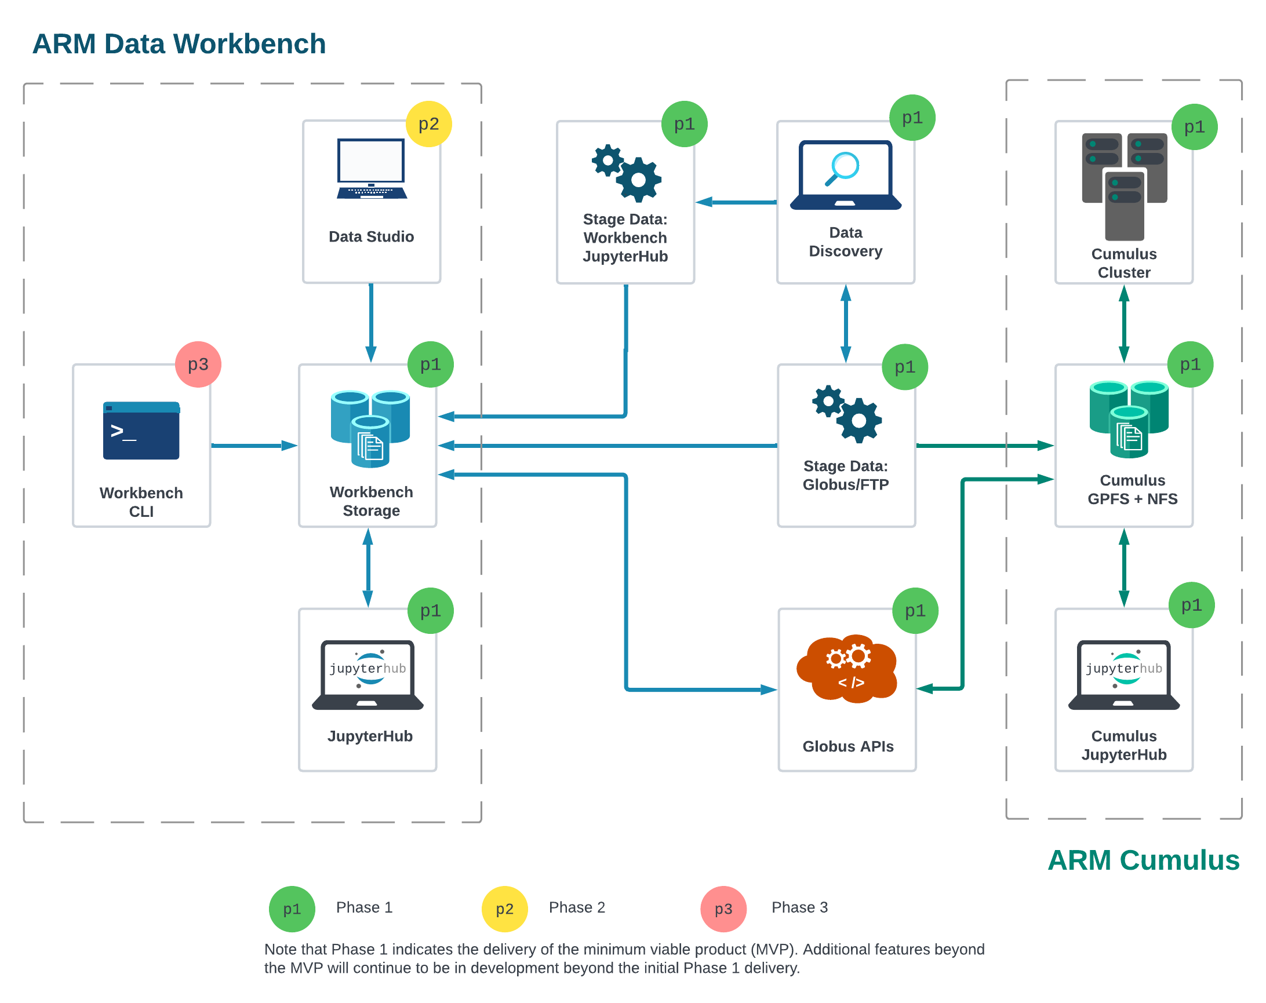
ARM Data Workbench Timeline
Phase 1: (COMPLETE)
JupyterLab integration with Discovery and ordering
Phase 2:
Initial UI to support querying, filtering, and data management functionality
Phase 3:
Expanding support for APIs and CLI capabilities

Slide 5
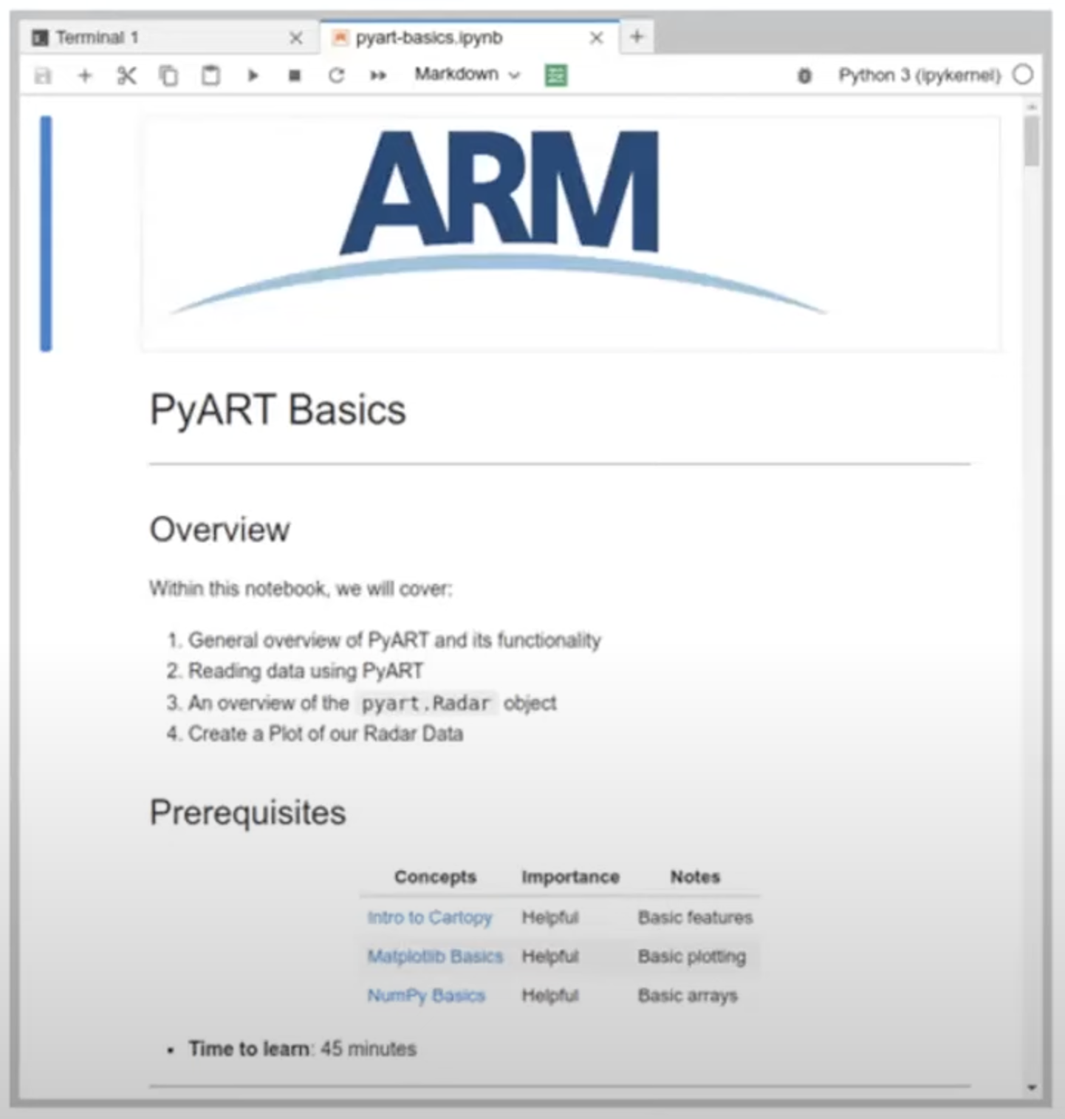
Jupyter Notebook
A development environment for creating and sharing computational documents.
Most commonly known for Python, but can support other languages as well.
Interactive code.
Easy to see and communicate how a program unfolds since the outcome of each cell/block is cached.
The “classic” notebook interface for editing documents.
Notebooks are the individual files that can be created, edited, and shared. (.ipynb files)

Slide 6
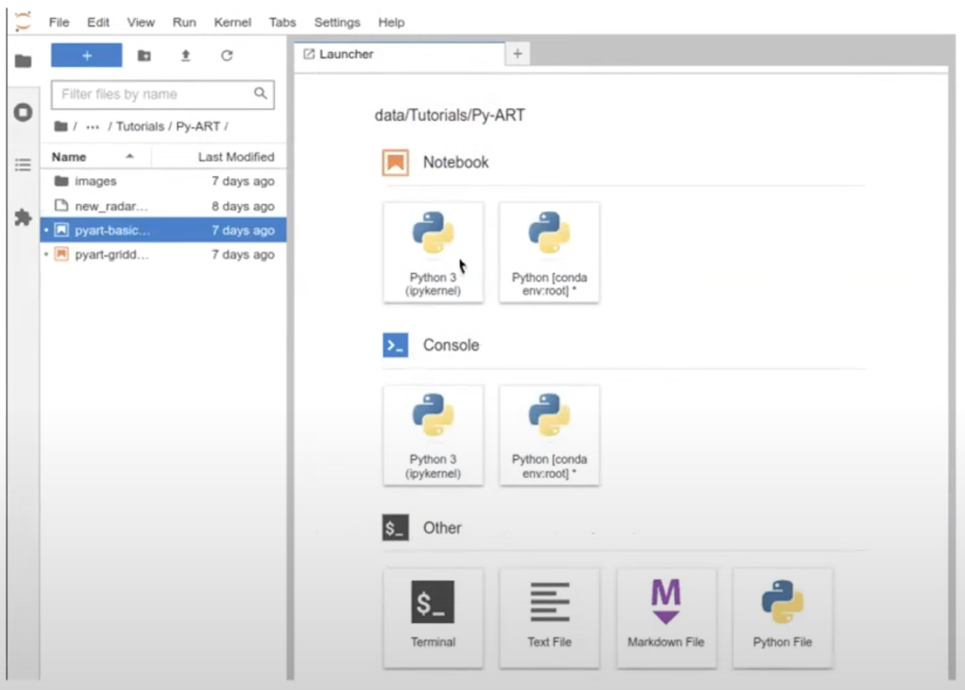
JupyterLab
A web-based interactive development environment for notebooks.
Includes file system navigation, the ability to edit notebooks, open a console, and terminal options.
Note that JupyterLab and Jupyter Notebooks can be installed on your local machine.

Slide 7
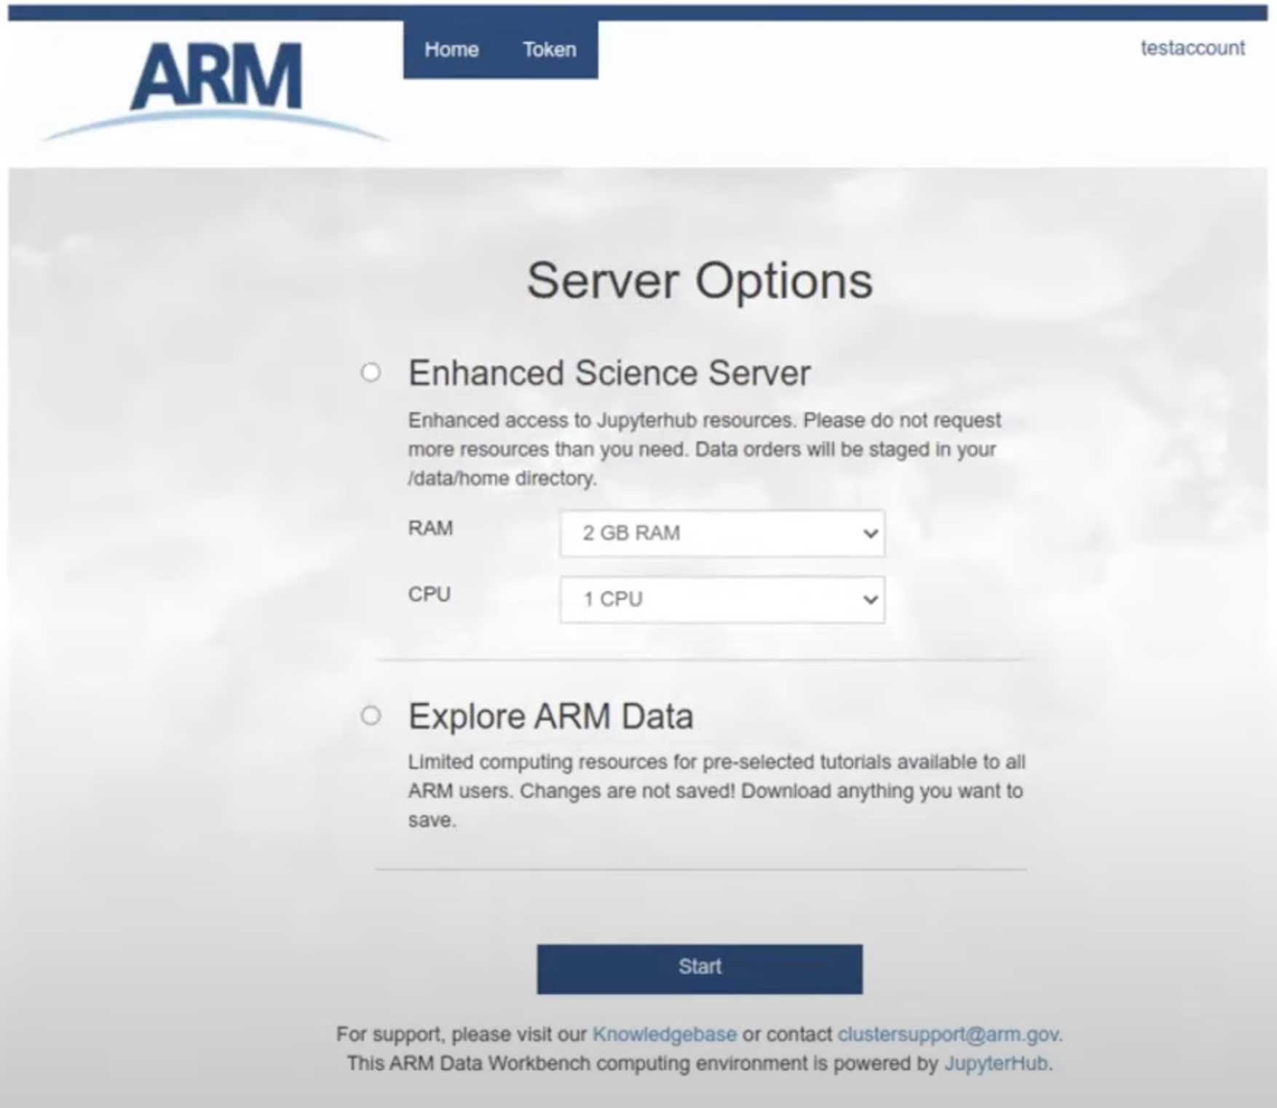
JupyterHub
A application for making JupyterLab and notebooks available in a multi-tenant environment.
Each user spawns their own private JupyterLab web server.
Benefits include:
Don’t have to setup environment.
Give users consistent access to same dependencies and packages.
For ARM users, mount personal and shared project storage from NFS.
Integration with ARM Data Discovery.

Slide 8
Service Levels
Explore ARM Data (Everyone)
Default access with limited resources without persistent file storage.
Enhanced Science Server (Requestable)
Scalable resources with persistent private & shared project spaces.
Research System Server (ARM Infrastructure Users)
Same as the enhanced with additional mounts to internal resources (datastream, archive).
Workshop & Tutorial Access (NEW)
A custom implementation of JupyterHub tailored to the needs of workshops. Instructors can get access to participants JupyterLab instances.

Slide 9
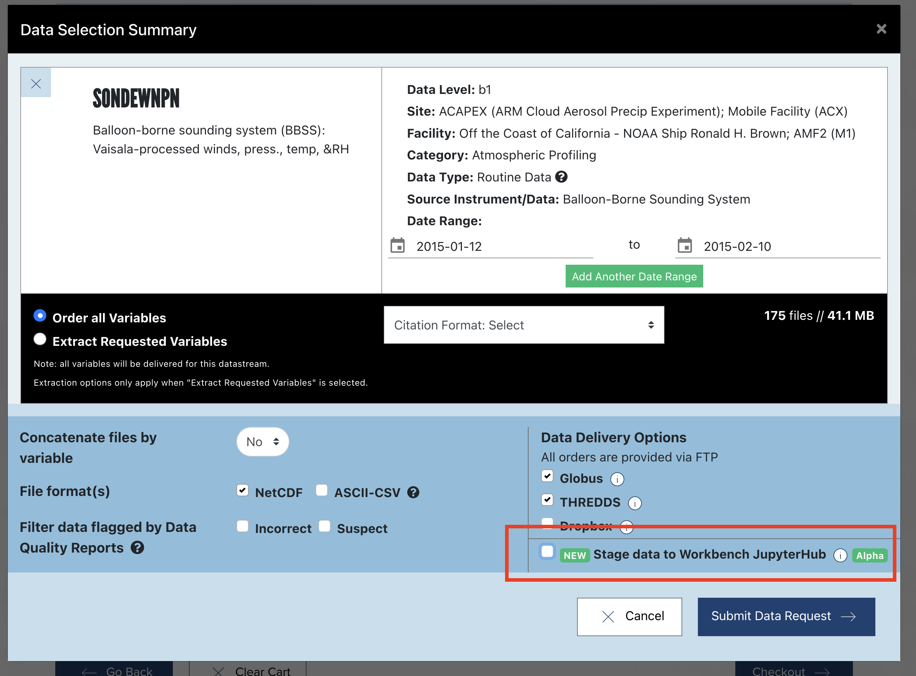
How to Access These Resources
Directly
https://jupyterhub.arm.gov
*Workshops have a dedicated link
Data Discovery
https://adc.arm.gov/discovery
Homepage
When Ordering
Your Account
ARM.gov
https://arm.gov
Go to Capabilities > Computing Resources >
JupyterHub & ARM Data Workbench

Slide 10
Demo Time

Slide 11
Thank You!
If you need any assistance, please stop by the ARM Data Booth and we will be happy to help.
You can also reach us by email:
clustersupport@arm.gov
adc@arm.gov

